Slide 1
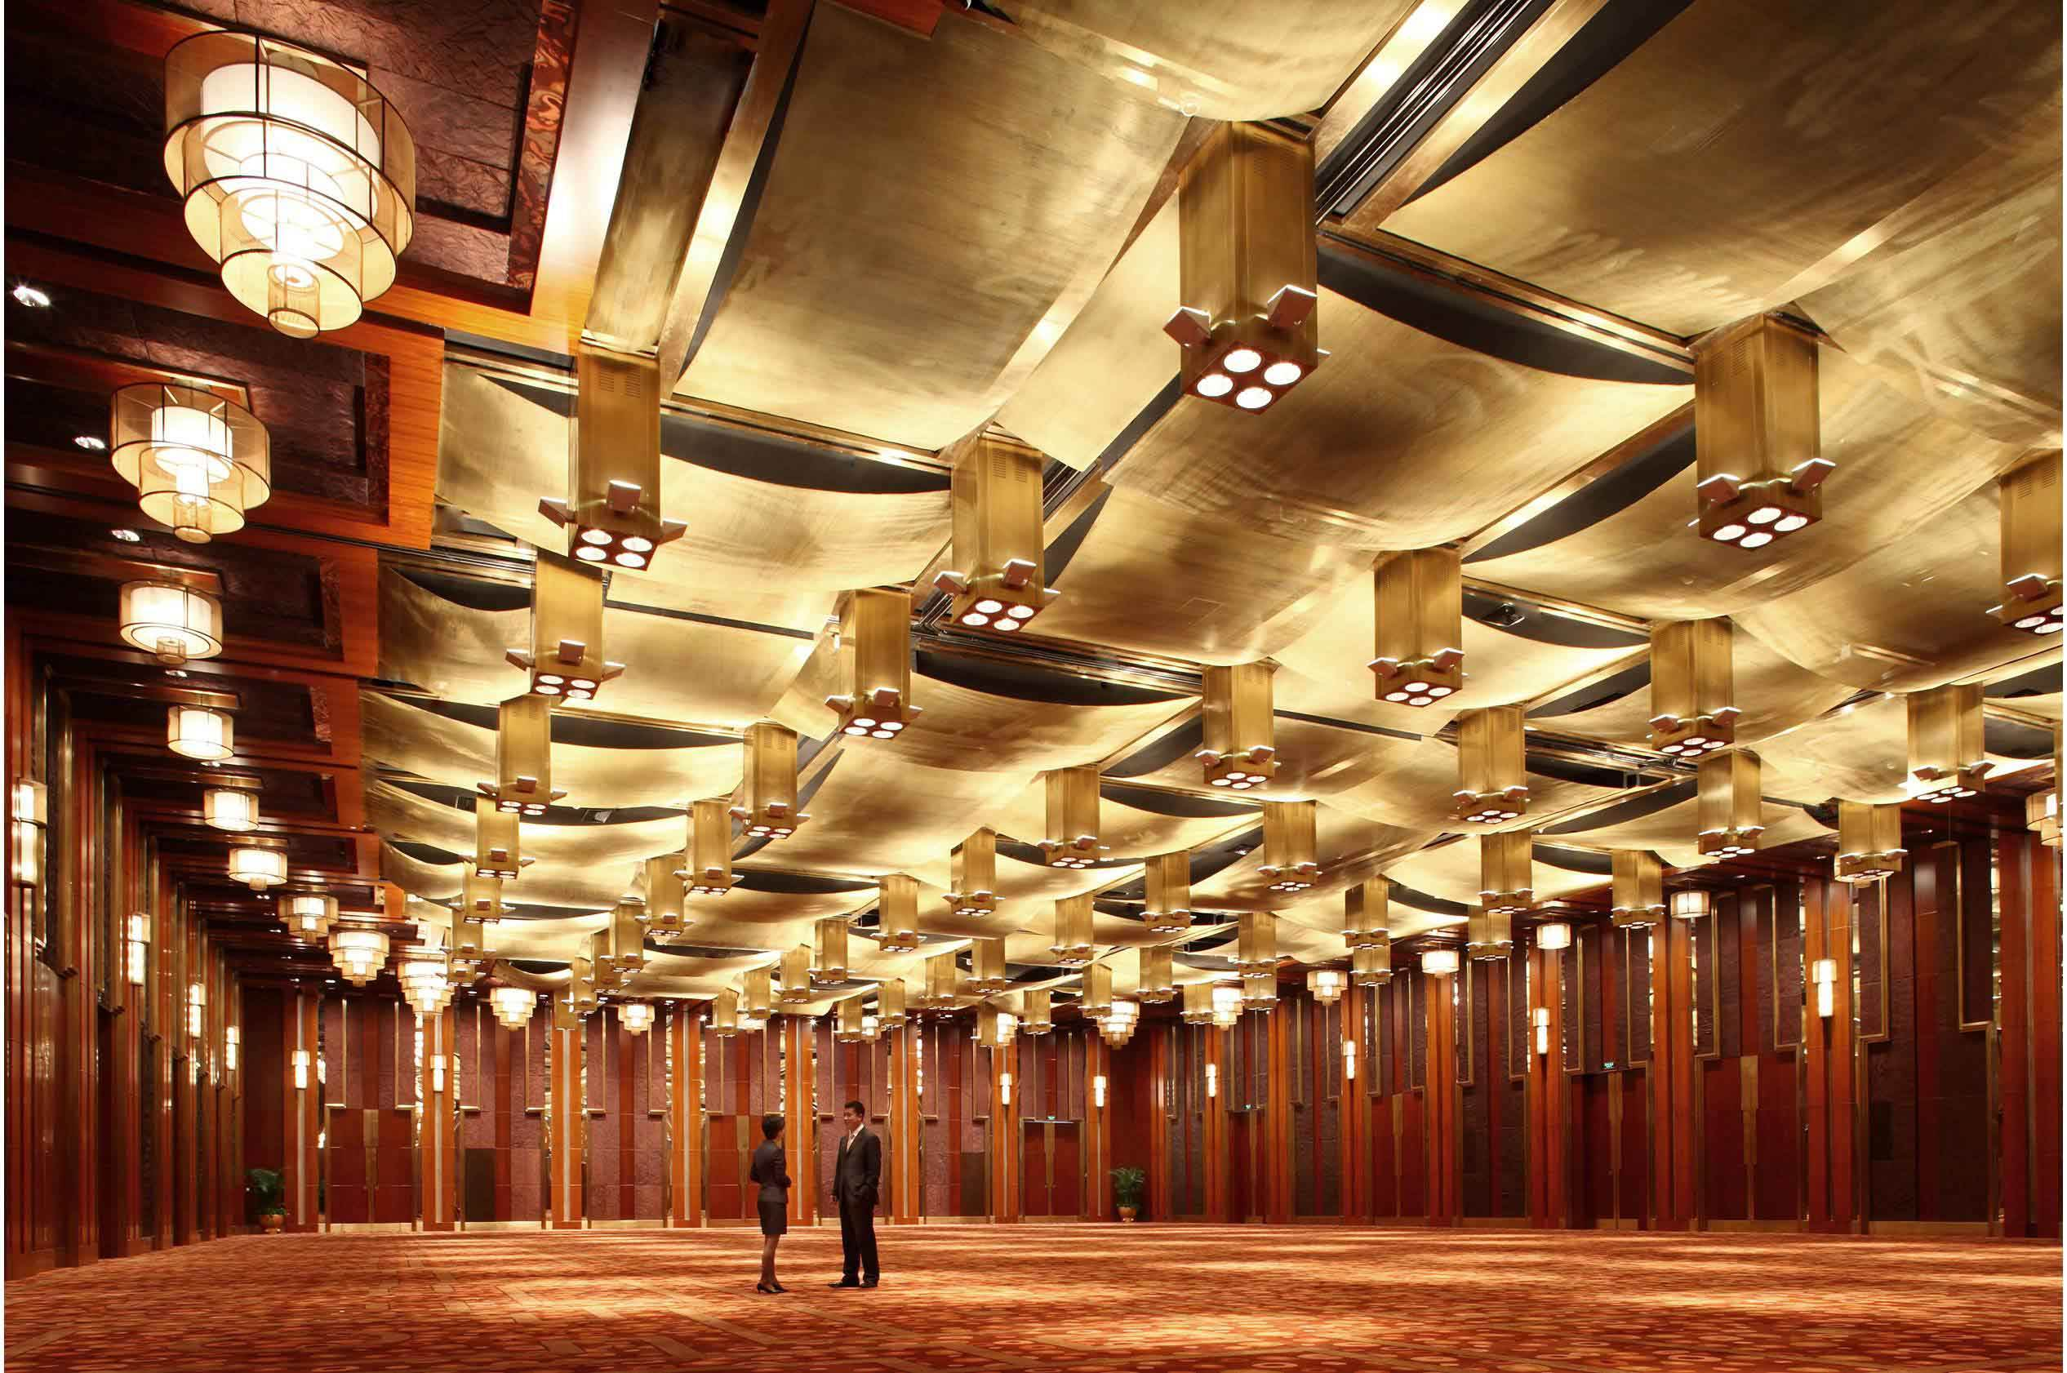
MoVIS A Movement and Proximity Visualization Tool Specially Designed for Conference Organizers
Group 6: Heber Ng, Li Jing, Xie Weiyi

Slide 2
Content
1
Background & Motivation
Objectives
Tools & Packages
Design Framework
App Demo using Use Case
Challenges & Lessons Learnt
Future Work
2
3
4
5
6
7

Slide 3
Background & Motivation
Emergence of Internet of Things (IoT)
Increasing trend in adoption of wearable devices, such as smart badges in monitoring and improving security measures and crowd control procedures in events.
Opportunities:
Lack of analytical power in some monitoring systems
Type of information flow: Push/Pull vs Interactive
How data are presented and shared: numbers vs graphs
Notes:
Rise of internet of things allows for adaptation of wearable devices to track individual movement in an area
This can be used for crowd management and monitoring situation on the ground to allow for more timely and appropriate response to emergency
Although there is a wide range of monitoring systems available in the market, there are a lack of analytical power in these system
The presentation of the data is lacking
Use case: over 51k sensor readings across 3 days

Slide 4
Objectives
To develop an interactive web application using R Shiny for conference organizers to:
Visualize attendees’ movements in the event space
Draw insights on crowd densities as well as connectedness of different event locations
Advantages:
Interactivity – allows users to interactively explore the data
Accessibility – easy access through webs
Reusability – fit for any dataset of a certain format
Notes:
Our objective is to develop an interactive web application using R Shiny to visualize
attendees’ movement in the event space,
crowd density
connectedness
Putting it as a web app not only allows the user to interactively explore and analyze the data, but also has added advantages of making the tool easily available through web browsers and enable different datasets of the designated format to be analyzed and visualized.

Slide 5





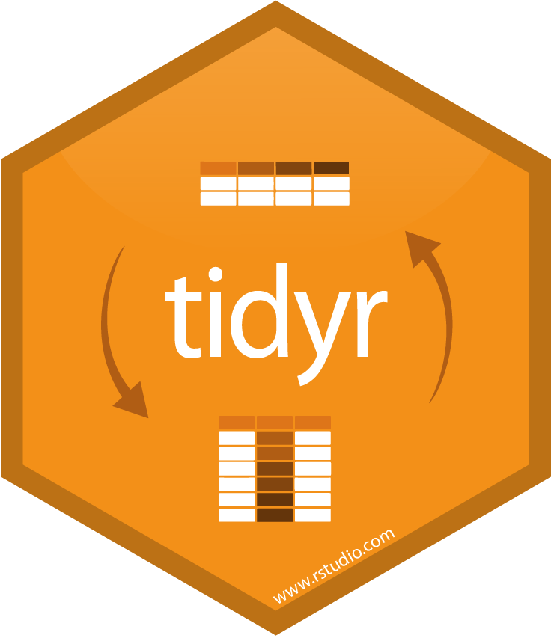

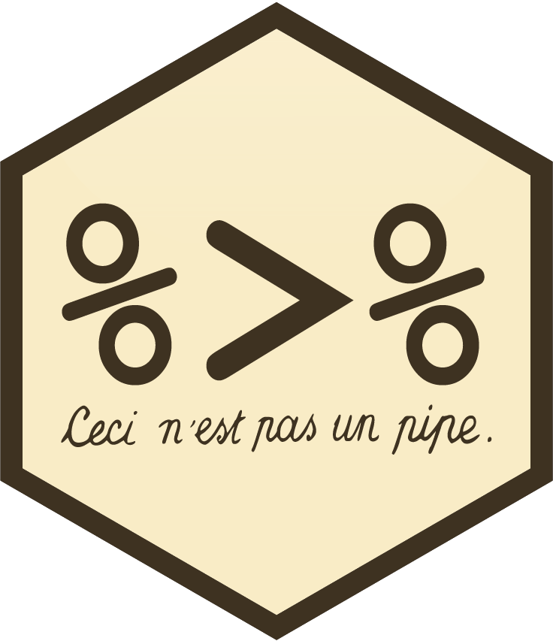
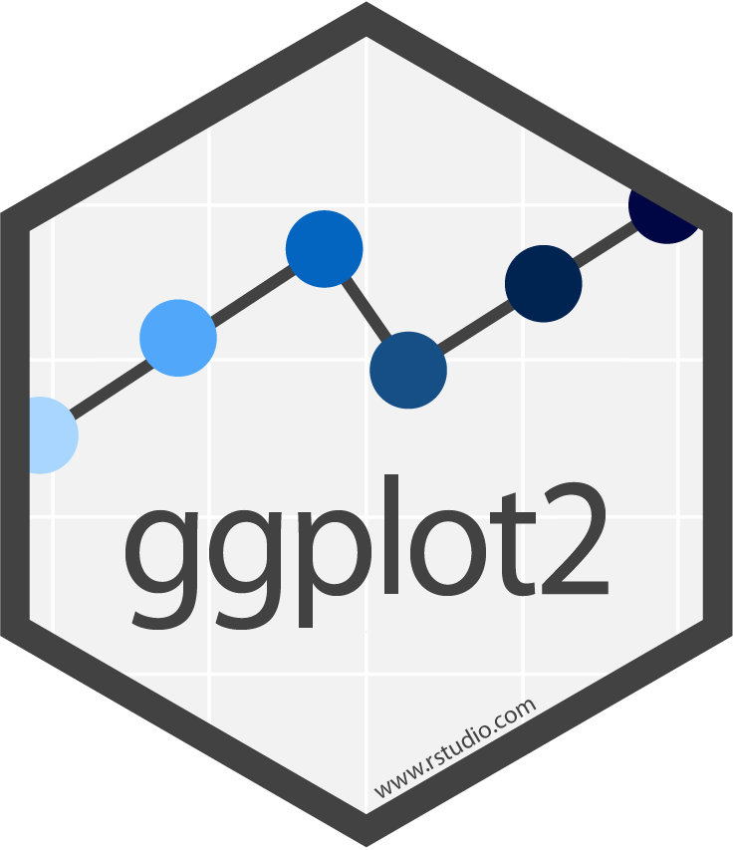

Tools and Packages
Function | Packages
Web Application | shiny, shinydashboard, shinyjs
Data Preparation | tidyverse, lubridate, sqldf
Crowd Analysis | plotly, ggridges, ggplot2
Network Analysis | igraph, tidygraph, visNetwork, chorddiag, sunburstR
Notes:
For this web app, we used multiple different R packages for the various functionalities.

Slide 6
Tools and Packages
Traditional R Shiny Approach
Our R Shiny Approach
shiny_app
shiny_app
ui.R
server.R
global.R
www
www
logic.R
Panel1.R
Panel2.R
Panel3.R
Contains both ui and server code
Notes:
For the code structure of the app, we used a different approach from the traditional R Shiny code structure

Slide 7
Comparison of 2 Approaches
Area | Traditional Approach | Our Approach
Code management | Code is consolidated into ui.R and server.R | Better code management due to panels separated into individual files
React element name collision | Due to code consolidation, chances of React element names colliding is high | React elements are encapsulated into modules, less chance of collision
Repetitive code | Repeated code for elements serving similar functions | Modules can be re-used with minor changes by setting the parameters
Parallel development | Requires merging of code on the 2 R files | Different team members can work on individual files
Complexity | Easier to prototype due to less rigid code structure and feedback | Code structure is more complex, requires restarting of app to see changes

Slide 8
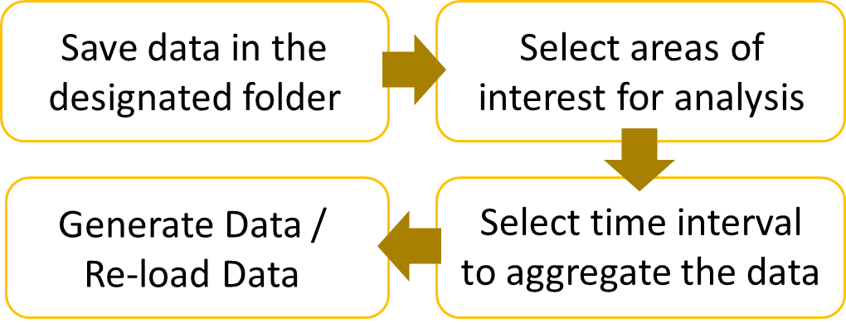
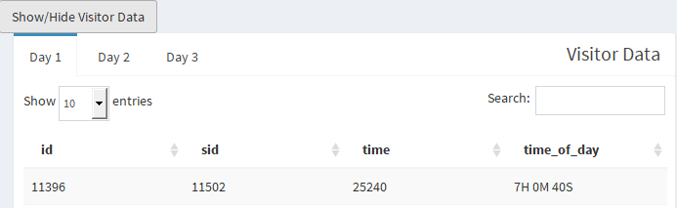
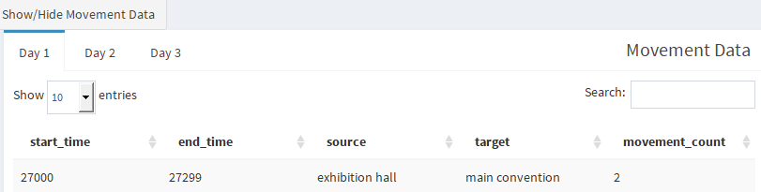
Design Framework
Data Preparation
Crowd Analysis
Network Analysis
Path Analysis
To prepare and transform data into desired format for subsequent analysis
1. Data Preparation & Transformation
2. Data Preview
Visitor Data
Simplified Visitors Data
Area Crowd Data
Movement Data
Path Data
Notes:
Our app have 4 major functions
The first of which is data preparation. This tab allows the user to generate data based on area of interest and time. The user can control which areas he wishes to have data for analysis in addition to the level of aggregation for the data based on time intervals.

Slide 9
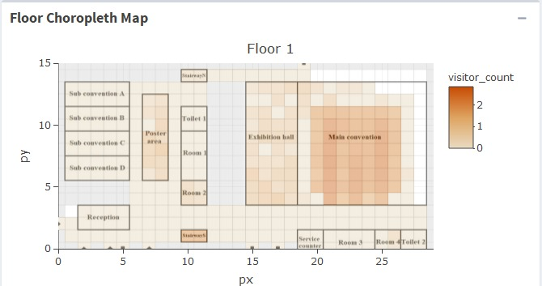
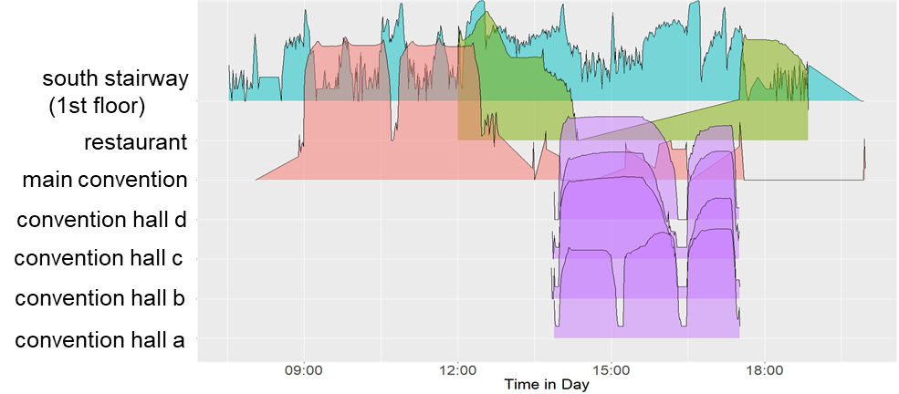
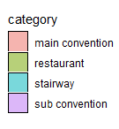
Design Framework
Data Preparation
Crowd Analysis
Network Analysis
Path Analysis
To visualize crowd densities and changes in crowd distributions in the event space over time
1. Floor Choropleth Map
2. Ridgeline Plot
To visualize crowd densities across event space
To visualize changes in crowd distributions over time and event space.
Notes:
The 2nd tab contains the tools used for analyzing crowd density and distribution in the event space over time. It uses the data prepared from the previous tab to show where the visitors are over the duration of the event. Both longitudinal and vertical time slice view of this data is provided.

Slide 10
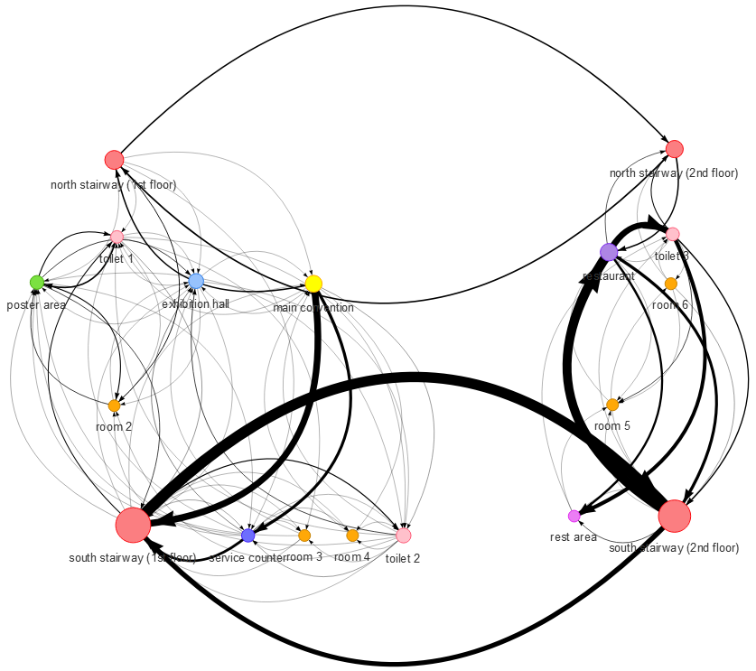
Design Framework
Data Preparation
Crowd Analysis
Network Analysis
Path Analysis
To visualize crowd flow from area to area and interconnections of functional areas
Directed Weighted Network Diagram
To visualize interconnections of different functional areas
Centrality Measures – importance of each location
In-degree | Sum of weights of all in-coming edges
Out-degree | Sum of weights of all out-going edges
Betweenness | No. of shortest paths going through a node
Closeness | How many steps required to access every other node from a given node
Notes:
The 3rd tab shows the crowd flow from area to area and how these areas are connected. It uses a directed and weighted network diagram to illustrate both the direction and volume of visitor flow. We also introduce different centrality measures to indicate the importance of each location. The 4 measures we used are In-degree, Out-degree, Betweenness and Closeness.
In-degree/Out-degree: Is the summation of all incoming/outgoing flow for each area
Betweenness is the fraction of short paths that is going through a area
Closeness is the average distance it takes to travel to every other node in the graph

Slide 11
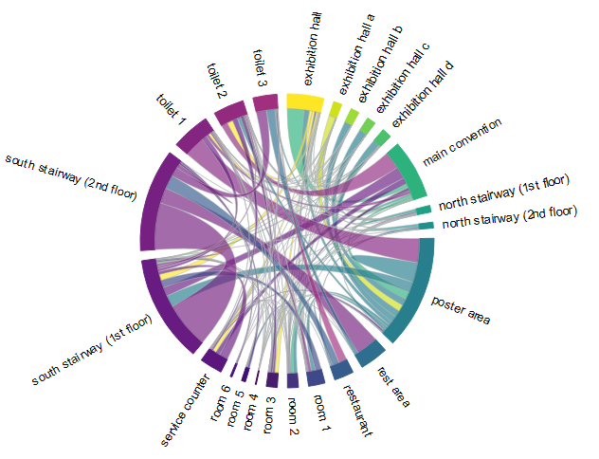
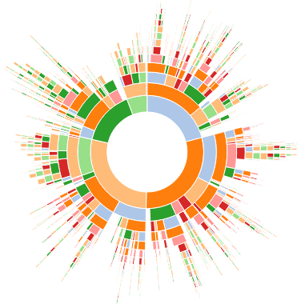
Design Framework
Data Preparation
Crowd Analysis
Network Analysis
Path Analysis
To visualize attendees’ paths in a hierarchical order and correlations between areas
1. Chord Diagram
2. Sunburst Diagram
To visualize interrelationships of locations
To visualize paths of conference attendees
Notes:
Lastly the Path analysis tab have 2 components:
The Sunburst diagram shows all the touchpoints that visitors traveled through during a period of time
Meanwhile the Chord Diagram shows the interrelationships of locations.

Slide 12
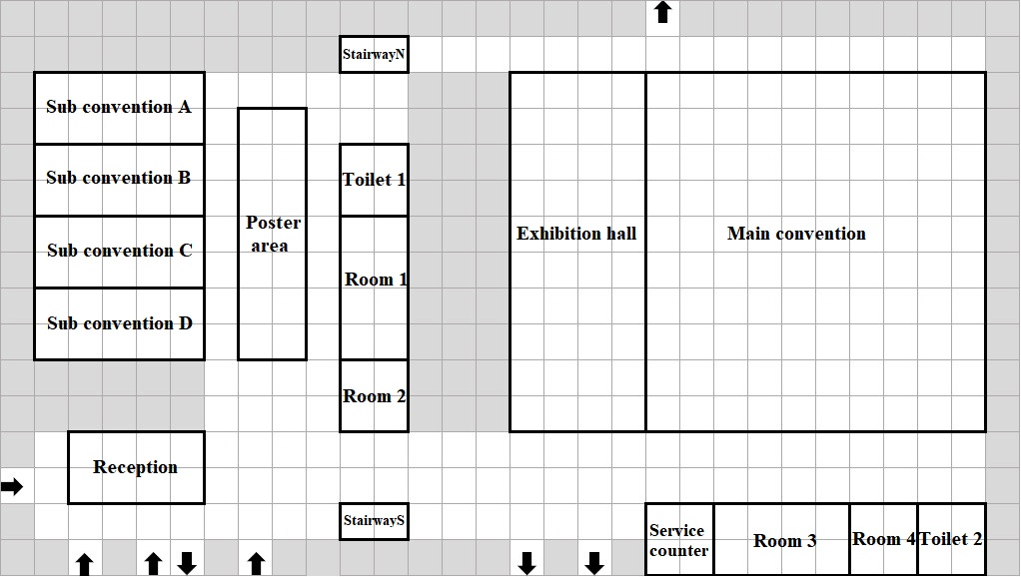
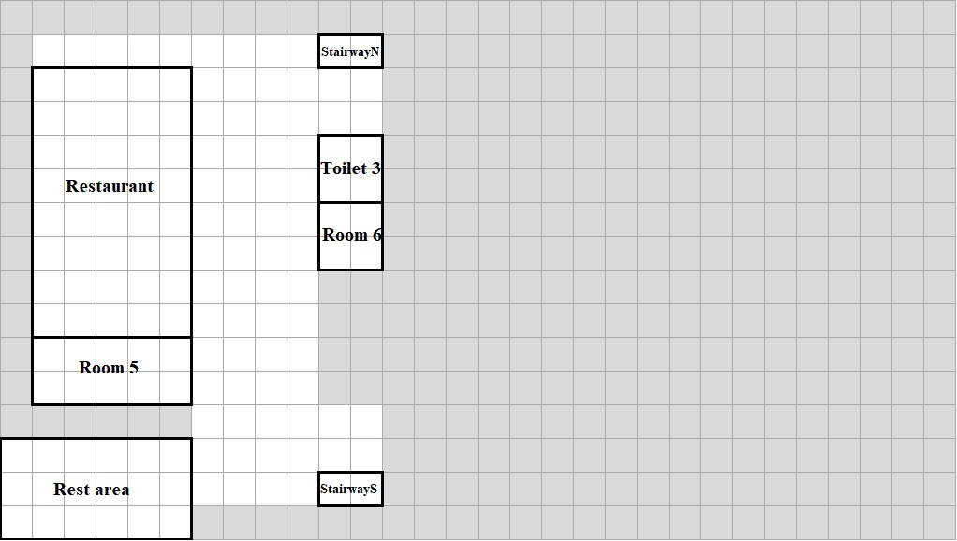
Overview of Use Case
Datasets: ChinaVis 2019 Mini Challenge 1
Sensor Location: sensor id, floor, x & y coordinates
Sensor Log: sensor id, attendee id, timestamp
CICSC Conference
3-day event
~ 5000 attendees
Event space consists of 2 floors
Event space covered by a network of sensors located in an interval of 8 meters
Notes:
So for our use case, we have chosen the 2019 ChinaVis Mini Challenge 1 data set.

Slide 13
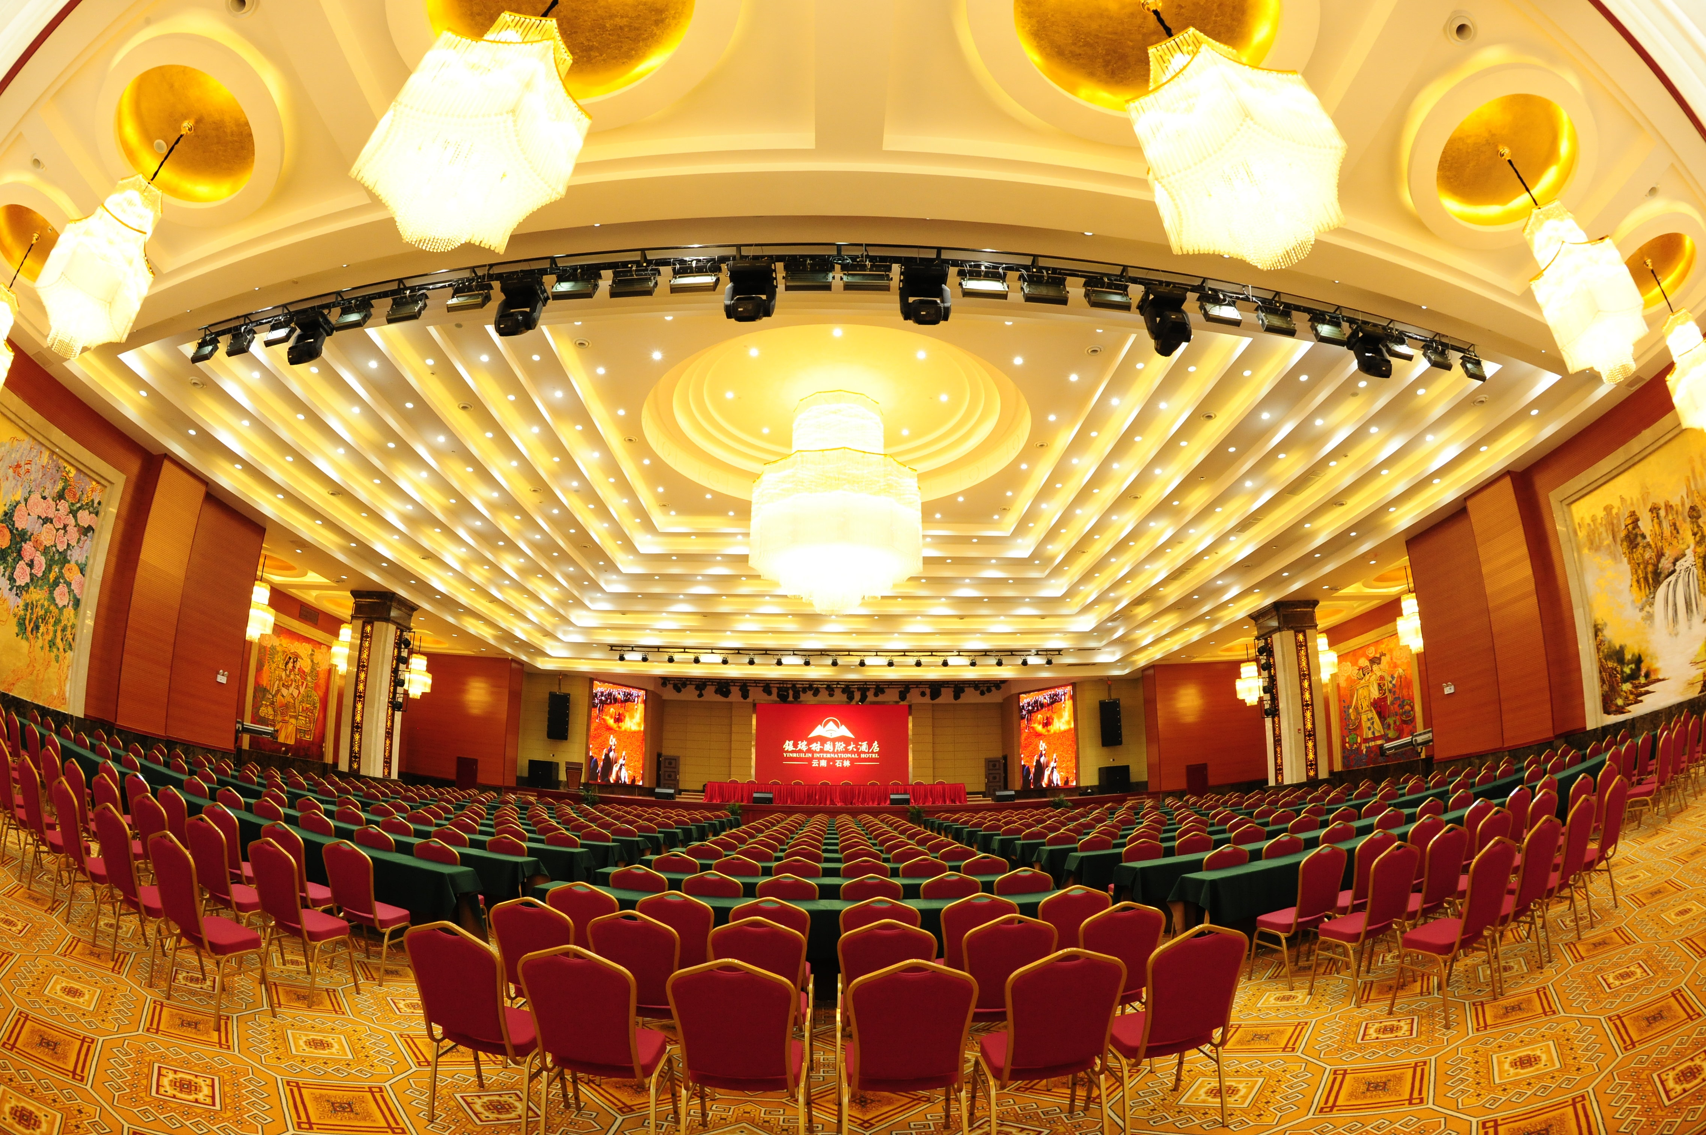
APP Demo - MoVIS

Slide 14
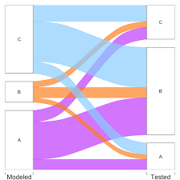
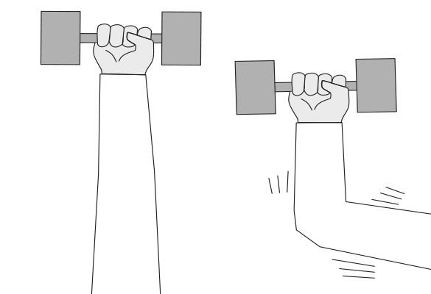
Challenges & Lessons Learnt
Choice of visualization tools
Sankey vs Sunburst Diagram
Slow data processing
Due to merging and aggregating of multiple large data frames
Optimized through introducing data preparation steps and storing as static data frames
Notes:
Due to the large number of observations in certain datasets, manipulating the data to fit into specific dimensions to be used in visualizations often takes a long time. This is particularly true when the data needed require merging and aggregating of multiple large dataframes

Slide 15
Future Work
Extend the functionality of the app, i.e. interrelationships between attendees and individual path visualization on a floor plan
Enable real-time feed of the data for monitoring and visualization
Enable ad-hoc reloading of the app by improving code structure

Slide 16

Q&A

